Slide 1
















Entity Linkage in Evolving Temporal Graphs
Data Intensive Systems - 2024
Utrecht University
Group #15
Instructor: Prof. Yannis Velegrakis
Alex Francis
Bar Melinarskiy
Sofia Bianchini

Slide 2
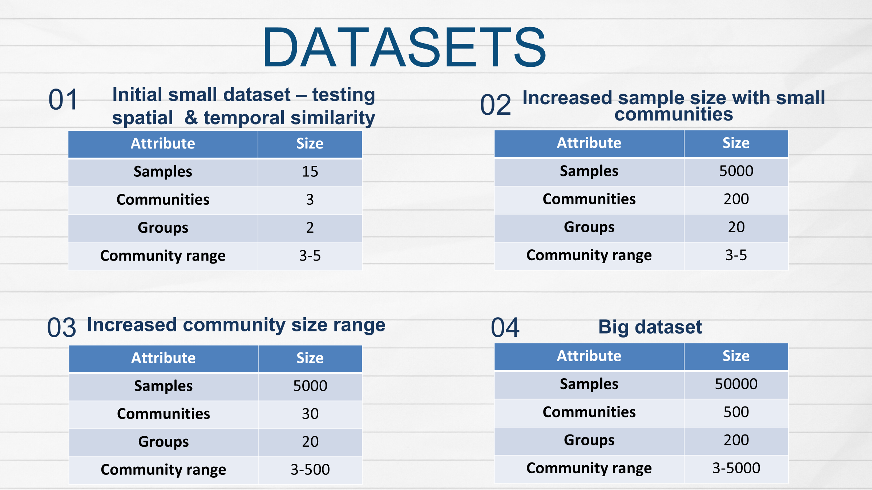

Slide 3






TECHNOLOGIES USED
Notes:
In this project, we will use the following tech tools – our solution is written in Python and uses popular libraries to work with Spark and NoSQL database for graphs called neo4j

Slide 4

Extract similar groups
SOLUTION GENERAL STEPS
Step 1
Step 2
Generate
datasets
Create preprocessing pipeline
Step 4
Step 3
Extract similar groups
Performance
evaluation

Slide 5
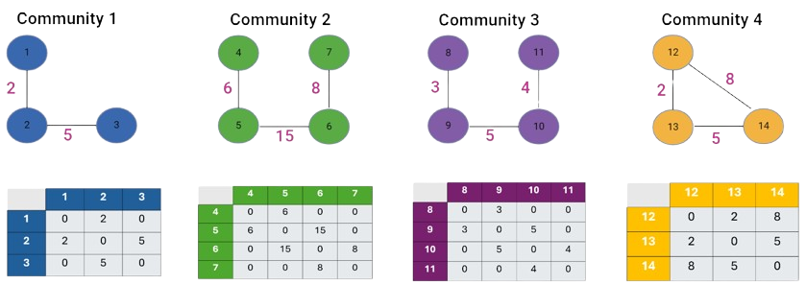
ADJACENCY MATRIX - TOY EXAMPLE

Slide 6
ADJACENCY MATRIX - TOY EXAMPLE

Slide 7
ADJACENCY MATRIX - TOY EXAMPLE
Communities Pair | Similarity Score
1 + 2 | 0.90

Slide 8
ADJACENCY MATRIX - TOY EXAMPLE
Communities Pair | Similarity Score
2 + 3 | 0.98

Slide 9
ADJACENCY MATRIX - TOY EXAMPLE
Communities Pair | Similarity Score
1 + 4 | 0.50

Slide 10
ADJACENCY MATRIX - TOY EXAMPLE
Communities Pair | Similarity Score
1 + 2 | 0.90
1 + 3 | 0.81
1 + 4 | 0.56
2 + 3 | 0.98
2 + 4 | 0.50
3 + 4 | 0.45
With 0.8 cutoff
threshold

Slide 11

THANK
YOU FOR LISTENING!

